Slide 1
JavaScript Essentials
Debugging JavaScript

Slide 2
Table of Contents
Types of Error
Browser DevTools
An erroneous example
Fixing syntax errors
Fixing logic errors
Other common errors

Slide 3

Lesson Objectives
Gain the ability and confidence to start fixing problems in your own code
Get familiar with Browser DevTools and able to use it to start troubleshooting problem
Inspect and manipulate runtime flows with Console

Slide 4
Types of Error
Section 1

Slide 5
Type of Error
Generally speaking, when you do something wrong in code, there are two main types of error that you'll come across:
Syntax errors: These are spelling errors in your code that actually cause the program not to run at all, or stop working part way through — you will usually be provided with some error messages too. These are usually okay to fix, as long as you are familiar with the right tools and know what the error messages mean!
Logic errors: These are errors where the syntax is actually correct but the code is not what you intended it to be, meaning that program runs successfully but gives incorrect results. These are often harder to fix than syntax errors, as there usually isn't an error message to direct you to the source of the error.
Notes:
Okay, so it's not quite that simple — there are some other differentiators as you drill down deeper.
But the above classifications will do at this early stage in your career. We'll look at both of these types going forward.

Slide 6
Type of Error – Summary
There are two main types of error that you'll come across: syntax error and logic error
Syntax error: spelling errors in your code that actually cause the program not to run at all
Logic error: syntax is actually correct but the code is not what you intended it to be

Slide 7
Browser DevTools
Section 2

Slide 8
Browser DevTools
Chrome DevTools is a set of web developer tools built directly into the Google Chrome browser. DevTools can help you edit pages on-the-fly and diagnose problems quickly, which ultimately helps you build better websites, faster.
Notes:
https://developers.google.com/web/tools/chrome-devtools/open

Slide 9
Browser DevTools
Notes:
https://developers.google.com/web/tools/chrome-devtools/open

Slide 10
Browser DevTools - Overview
DevTools is most important tools for every Front-end Developer
DevTools can help you edit pages on-the-fly and diagnose problems quickly, which ultimately helps you build better websites, faster.
Use DevTools wisely will improve you productively and save you hundred of hour

Slide 11
An erroneous example
Section 3

Slide 12
An erroneous example
To get started, let's return to our number guessing game — except this time we'll be exploring a version that has some deliberate errors introduced. Go to Github and make yourself a local copy of number-game-errors.html (see it running live here).
To get started, open the local copy inside your favorite text editor, and your browser.
Try playing the game — you'll notice that when you press the "Submit guess" button, it doesn't work
Notes:
Note: You might well have your own version of the game example that doesn't work, which you might want to fix! We'd still like you to work through the article with our version, so that you can learn the techniques we are teaching here. Then you can go back and try to fix your example.
At this point, let's consult the developer console to see if it reports any syntax errors, then try to fix them. You'll learn how below.

Slide 13
Events Object - Overview
Event object it is automatically passed to event handlers to provide extra features and information
The target property of the event object is always a reference to the element that the event has just occurred upon
e.target is incredibly useful when you want to set the same event handler on multiple elements and do something to all of them when an event occurs on them
Use event.preventDefault() method to prevent an event from doing what it does by default
Modern Browser supports Event capturing and Event bubbling mode (default)
Take advantage of Event Delegation to write less code but do more task

Slide 14
Fixing syntax errors
Section 4

Slide 15
Fixing syntax errors – Round 1
Earlier on in the course we got you to type some simple JavaScript commands into the developer tools JavaScript console (if you can't remember how to open this in your browser, follow the previous link to find out how).
What's even more useful is that the console gives you error messages whenever a syntax error exists inside the JavaScript being fed into the browser's JavaScript engine.
Now let's go hunting.

Slide 16
Fixing syntax errors – Round 1
Go to the tab that you've got number-game-errors.html open in, and open your JavaScript console. You should see an error message along the following lines:

Slide 17
Fixing syntax errors – Round 1
This is a pretty easy error to track down, and the browser gives you several useful bits of information to help you out (the screenshot above is from Firefox, but other browsers provide similar information). From left to right, we've got:
A red "x" to indicate that this is an error.
An error message to indicate what's gone wrong: "TypeError: guessSubmit.addeventListener is not a function"
A "Learn More" link that links through to an MDN page that explains what this error means in greater detail.
The name of the JavaScript file, which links through to the Debugger tab of the developer tools. If you follow this link, you'll see the exact line where the error is highlighted.
The line number where the error is, and the character number in that line where the error is first seen. In this case, we've got line 86, character number 3.

Slide 18

Fixing syntax errors – Round 1
If we look at line 86 in our code editor, we'll find this line:
The error message says "guessSubmit.addeventListener is not a function", which means that the function we're calling is not recognized by the JavaScript interpreter.
Often, this error message actually means that we've spelled something wrong.
If you are not sure of the correct spelling of a piece of syntax, it is often good to look up the feature on MDN.
The best way to do this currently is to search for "mdn name-of-feature" with your favorite search engine.
Here's a shortcut to save you some time in this instance: addEventListener().

Slide 19
Fixing syntax errors – Round 1
So, looking at this page, the error appears to be that we've spelled the function name wrong! Remember that JavaScript is case sensitive, so any slight difference in spelling or casing will cause an error. Changing addeventListener to addEventListener should fix this. Do this now.
Notes:
Note: See our TypeError: "x" is not a function reference page for more details about this error.

Slide 20
Fixing syntax errors – Round 2
Save your page and refresh, and you should see the error has gone.
Now if you try to enter a guess and press the Submit guess button, you'll see ... another error!
Notes:
Note: See our TypeError: "x" is not a function reference page for more details about this error.

Slide 21
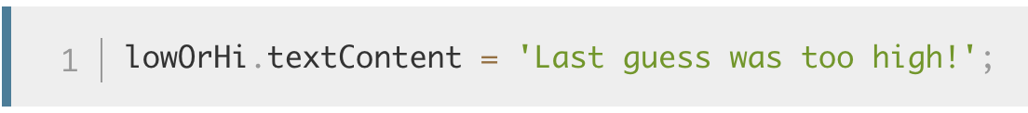
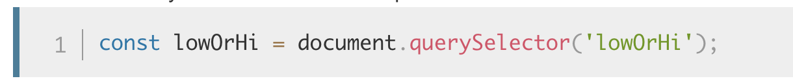
Fixing syntax errors – Round 2
This time the error being reported is "TypeError: lowOrHi is null", on line 78.
Have a look at line 78, and you'll see the following code:
This line is trying to set the textContent property of the lowOrHi constant to a text string, but it's not working because lowOrHi does not contain what it's supposed to. Let's see why this is — try searching for other instances of lowOrHi in the code. The earliest instance you'll find in the JavaScript is on line 48:
Notes:
Note: Null is a special value that means "nothing", or "no value". So lowOrHi has been declared and initialised, but not with any meaningful value — it has no type or value.
Note: This error didn't come up as soon as the page was loaded because this error occurred inside a function (inside the checkGuess() { ... } block). As you'll learn in more detail in our later functions article, code inside functions runs in a separate scope than code outside functions. In this case, the code was not run and the error was not thrown until the checkGuess() function was run by line 86.

Slide 22
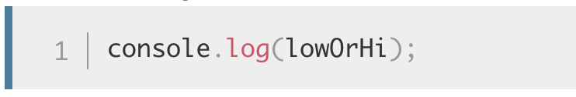
Fixing syntax errors – Round 2
At this point we are trying to make the variable contain a reference to an element in the document's HTML. Let's check whether the value is null after this line has been run. Add the following code on line 49:
Note: console.log() is a really useful debugging function that prints a value to the console. So it will print the value of lowOrHi to the console as soon as we have tried to set it in line 48.

Slide 23
Fixing syntax errors – Round 2
Save and refesh, and you should now see the console.log() result in your console

Slide 24
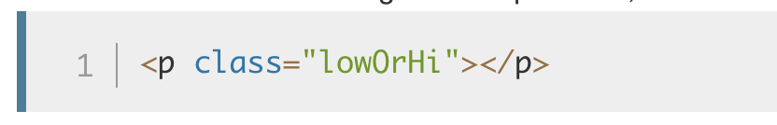
Fixing syntax errors – Round 2
Sure enough, lowOrHi's value is null at this point, so there is definitely a problem with line 48.
Let's think about what the problem could be. Line 48 is using a document.querySelector() method to get a reference to an element by selecting it with a CSS selector. Looking further up our file, we can find the paragraph in question:

Slide 25
Fixing syntax errors – Round 2
So we need a class selector here, which begins with a dot (.), but the selector being passed into the querySelector() method in line 48 has no dot. This could be the problem! Try changing lowOrHi to .lowOrHi in line 48.
Try saving and refreshing again, and your console.log() statement should return the <p> element we want. Phew! Another error fixed! You can delete your console.log() line now, or keep it to reference later on — your choice.
Notes:
Note: See our TypeError: "x" is (not) "y" reference page for more details about this error.

Slide 26
Fixing syntax errors – Practice Time
Now if you try playing the game through again, you should get more success — the game should play through absolutely fine, until you end the game, either by guessing the right number, or by running out of guesses.
At that point, the game fails again, and the same error is spat out that we got at the beginning — "TypeError: resetButton.addeventListener is not a function"! However, this time it's listed as coming from line 94.
Looking at line number 94, it is easy to see that we've made the same mistake here. We again just need to change addeventListener to .addEventListener. Do this now.

Slide 27
Fixing syntax errors - Summary
Syntax errors: are easy to find since JavaScript console will display an error if it encounter any syntax error at compile time or runtime
Use Console DevTools along with console.log() to investigate the root cause.
Once you find the cause, try to think about why that happened, what is going wrong. From that you can come up with a fix

Slide 28
Fixing logic errors
Section 5

Slide 29
Fixing logic errors
At this point, the game should play through fine, however after playing through a few times you'll undoubtedly notice that the "random" number you've got to guess is always 1. Definitely not quite how we want the game to play out!
There's definitely a problem in the game logic somewhere — the game is not returning an error; it just isn't playing right.

Slide 30
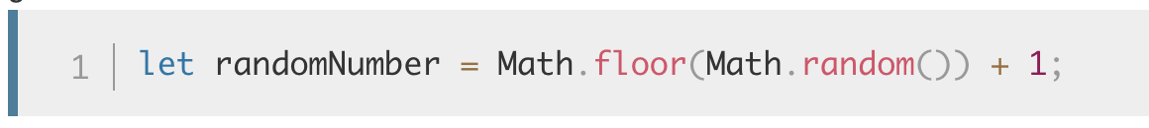
Fixing logic errors
Search for the randomNumber variable, and the lines where the random number is first set. The instance that stores the random number that we want to guess at the start of the game should be around line number 44:

Slide 31
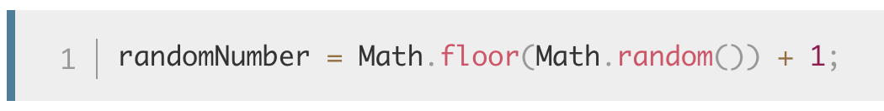
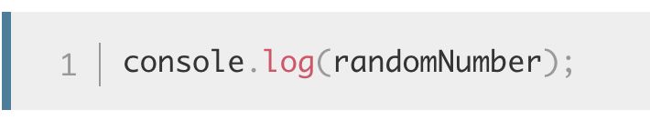
Fixing logic errors
And the one that generates the random number before each subsequent game is around line 113:
To check whether these lines are indeed the problem, let's turn to our friend console.log() again — insert the following line directly below each of the above two lines:
Notes:
Save and refresh, then play a few games — you'll see that randomNumber is equal to 1 at each point where it is logged to the console.

Slide 32
Fixing logic errors – Work through logic
To fix this, let's consider how this line is working. First, we invoke Math.random(), which generates a random decimal number between 0 and 1, e.g. 0.5675493843.
Next, we pass the result of invoking Math.random() through Math.floor(), which rounds the number passed to it down to the nearest whole number. We then add 1 to that result:
Rounding a random decimal number between 0 and 1 down will always return 0, so adding 1 to it will always return 1. We need to multiply the random number by 100 before we round it down. The following would give us a random number between 0 and 99: Math.floor(Math.random()*100);
Hence us wanting to add 1, to give us a random number between 1 and 100: Math.floor(Math.random()*100) + 1;
Try updating both lines like this, then save and refresh — the game should now play like we are intending it to!

Slide 33
Fixing logic errors – Summary
Logic errors are hard to catch as you need to understand the logic of your program in order to fix it
It’s very important to understand the requirement before you code
A misunderstanding of requirement will easily cause logic errors in your program
And you can’t fix those errors until you fully understand the requirement

Slide 34
Other common errors
Section 6

Slide 35
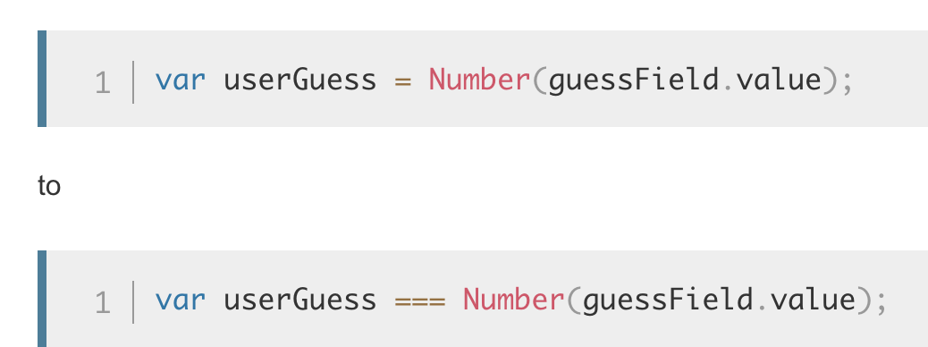
Other common errors
There are other common errors you'll come across in your code. This section highlights most of them.
SyntaxError: missing ; before statement
This error generally means that you have missed a semicolon at the end of one of your lines of code, but it can sometimes be more cryptic. For example, if we change this line inside the checkGuess() function:
Notes:
https://developer.mozilla.org/en-US/docs/Web/JavaScript/Reference/Errors/Missing_semicolon_before_statement

Slide 36
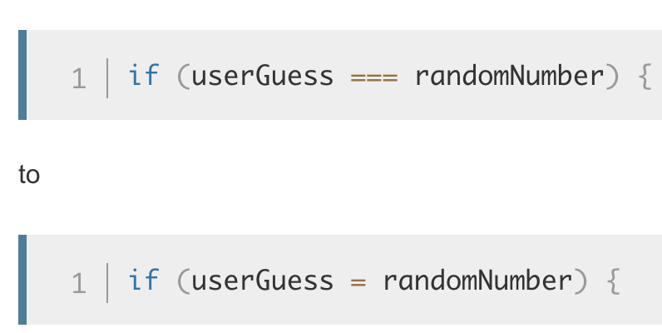
Other common errors
The program always says you've won, regardless of the guess you enter
This could be another symptom of mixing up the assignment and strict equality operators. For example, if we were to change this line inside checkGuess():
Notes:
the test would always return true, causing the program to report that the game has been won. Be careful!

Slide 37
Other common errors
SyntaxError: missing ) after argument list
This one is pretty simple — it generally means that you've missed the closing parenthesis at the end of a function/method call.
Notes:
https://developer.mozilla.org/en-US/docs/Web/JavaScript/Reference/Errors/Missing_parenthesis_after_argument_list

Slide 38
Other common errors
SyntaxError: missing : after property id
This error usually relates to an incorrectly formed JavaScript object, but in this case we managed to get it by changing

Slide 39
Other common errors
SyntaxError: missing } after function body
This is easy — it generally means that you've missed one of your curly braces from a function or conditional structure. We got this error by deleting one of the closing curly braces near the bottom of the checkGuess() function.

Slide 40
Other common errors
SyntaxError: expected expression, got 'string' or SyntaxError: unterminated string literal
These errors generally mean that you've left off a string value's opening or closing quote mark. In the first error above, string would be replaced with the unexpected character(s) that the browser found instead of a quote mark at the start of a string. The second error means that the string has not been ended with a quote mark.
For all of these errors, think about how we tackled the examples we looked at in the walkthrough. When an error arises, look at the line number you are given, go to that line and see if you can spot what's wrong. Bear in mind that the error is not necessarily going to be on that line, and also that the error might not be caused by the exact same problem we cited above!
Notes:
https://developer.mozilla.org/en-US/docs/Web/JavaScript/Reference/Errors/Unexpected_token
https://developer.mozilla.org/en-US/docs/Web/JavaScript/Reference/Errors/Unterminated_string_literal

Slide 41
Other common errors – Summary
Real program won’t always be that simple to work out what's wrong in your code
This will save you a few hours of sleep and allow you to progress a bit faster when things don't turn out right, especially in the earlier stages of your learning journey
Notes:
Ref: https://developer.mozilla.org/en-US/docs/Web/JavaScript/Reference/Errors

Slide 42

Thank you
Q&A

